Slide 1









Friends don’t let
friends be Hexagons
Nobody Notices
What I Do,
Until I don’t Do it.
ChatGPT-OS
Just ask
and it knows
Protected
By
Cryptolocker
The spider infestation
problem is mostly
resolved
If I were an Octopus,
I’d twirl around and
bitch slap you 8 times.
Approved for testing in PRODUCTION only
Only spill
imported beers on keyboard
It’s not so much a thankless job,
it’s more a job with no thanks.

Slide 2








?
?
?
?
TRY
Before you say it’s my fault,
are you sure it was my job?
?
SHITPOSTING
?
?
It’s better than thinking!
Commit to the bit
and don’t say shit.
We do this not
because it is easy,
but because we
thought it would be easy.
Not
Powerpoint
ready
Unoptimized
For
Excel
Shartpoint
Free Zone
Approved for
Outdoor/Indoor
use only.
Please unplug
while in use.
Not
safe for
Word
Just say
no to
Outlook
F*ck
Teams

Slide 3






I am not responsible
for your actions.
I am not responsible
for your actions.
WITH 50%
MORE MALWARE!!
100% HACKABLE!
My password is password
ChatGPT
Backup &
Recovery
Certified
Protected by
Cryptolocker
TeamViewer
Pre-Installed

Slide 4

CULT OF THE
CEILING SNAKE
Computer
As Fuck
Can’t tread on snek if snek in ceiling
Dunning-Kruger
SHITPOSTING
CERTIFIED
INFOSEC
PROFESSIONAL
This incident wasn’t
caused by an Intern
TOP INSIGHTS
If you did it,
it isn’t bragging.
Don’t bark
if you can’t bite

Slide 5

STOP ALL THE
DOWNLOADING
Stressed
Depressed
Lemon Zest
FLOOR
LEMMINGS
CEILING
SNAKES
VS.
Starts at 10pm
Ends in DEATH!!
W.O.M.B.A.T.
Free Zone
(Waste Of Money Brains And Time)
Root cause of failure:
Failure to patch
Failure to update
Misconfiguration
Intern

Slide 6





Official US Census Webcam
DO NOT REMOVE
CAUTION:
Avoid Blockchains while
operating this device.
Penalties for unauthorized removal or tampering
with Official US Census devices may include fines
up to $5000.
For more info visit http://TikTok.cn/census
US Census Survey Webcam
DO NOT REMOVE
US Census Survey Webcam
DO NOT REMOVE
Penalties for unauthorized removal or tampering
with Official US Census devices may include fines
up to $5000.
For more info visit http://TikTok.cn/census
Penalties for unauthorized removal or tampering
with Official US Census devices may include fines
up to $5000.
For more info visit http://TikTok.cn/census
I’m not mean, I’m honest.
The truth hurts. Here’s a
Band-aid.
NOTICE:
All data on this device
has been exfiltrated to
https://pastebin.com/6dMZ1ErC

Slide 7
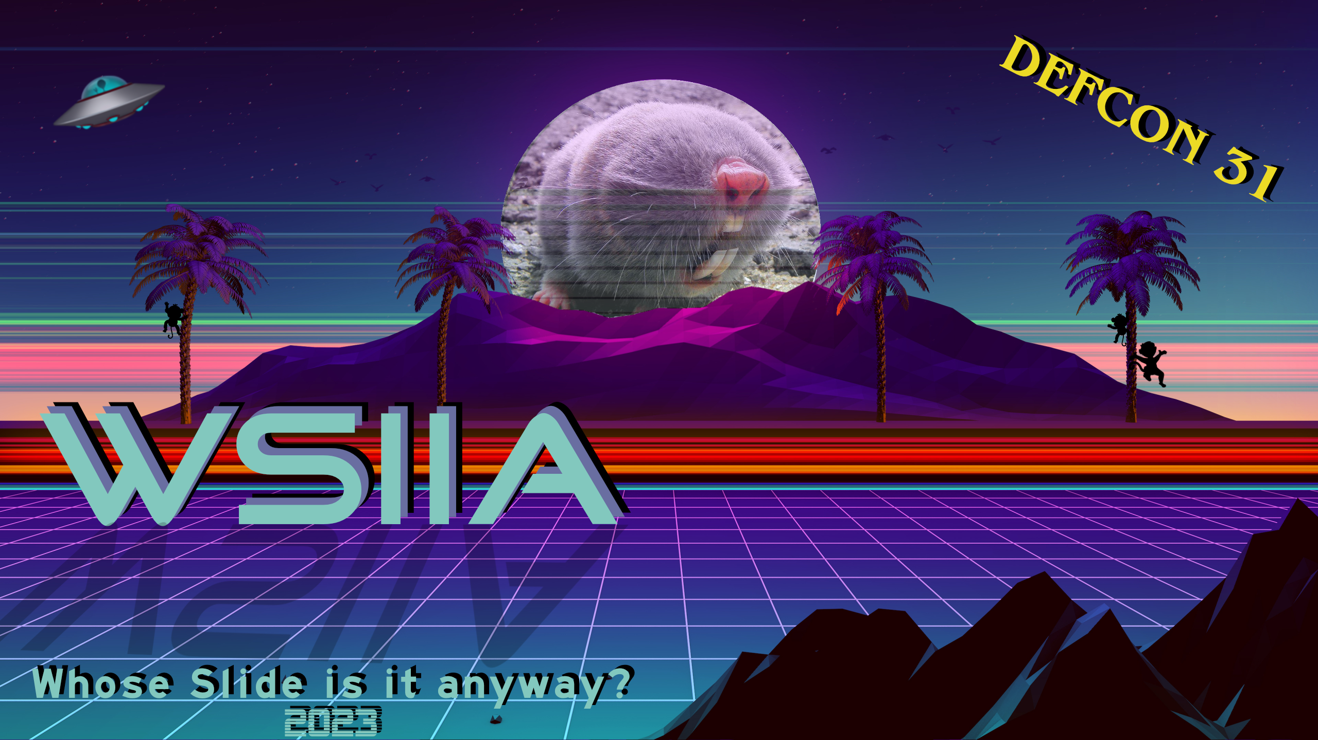
PLEASE
DO NOT DISTURB
This device is protected.
FAFO
CERTIFIED
INFOSEC
CHARLATAN
This device is part of an on-going
research project being conducted
by approved security researchers.
Call (605)475-6968 before handling device
Re-order No. 1337420

Slide 8



CAUTION
RFI Chips contained in this package have a
half-life of 37 years.
Dispose of only in approved containers.
This
needs more
CAUTION
Cockwombling Wankpuffins have been
spotted in the in area. If you see one,
slowly exit the area and notify the
authorities at (206)569-5829.
Warn others to avoid the area
and proceed with extreme caution.
To answer your question:
Short answer: No
Longer answer: Nooooooooo
ooooooooooooooooooooooo

Slide 9



I
Toxic
Waste
If you're always the smartest
person in the room, you’re
probably in the wrong rooms
Contains:
MICROCHIPS
DO NOT EAT
THROW AWAY
SYNERGY!
SYNERGY!
:
WARNING:
May contain Dormant
Cyber Pathogens
:
WARNING:
WHY NOT BOTH?
May contain Dormant
Cyber Pathogens
WARNING
User is weird and
possibly pissed off.
:
WARNING:
May contain Dormant
Cyber Pathogens
A18
NOTICE
This device has been examined
and found to contain questionable
data. Please call (707)873-7862 for
recovery information.

Slide 10




OFFICIALY SANCTIONED
DEFCON
Approved
Shenanigan
*
*Not really, but Noid said we could do it,
it was cool
Approved Security
Research Equipment
This equipment is part of
the MSG Sphere security
monitoring system.
Do not remove or disturb.
In case of emergency:
Call 505-503-4455
Sensor: 82R99
Location: AF00201C
sphere
Let’s go into the woods
for a summoning…
tm

Slide 11





DEFCON 31
Stop worrying about your
job being stolen by A.I
Dino Sumo
Cage Match
TO THE DEATH!!
You can be replaced by
a shell script right now!
Safety Certified
Checked by Bob on 6/16/23
DAYS
WITHOUT AN
ACCIDENT

Slide 12
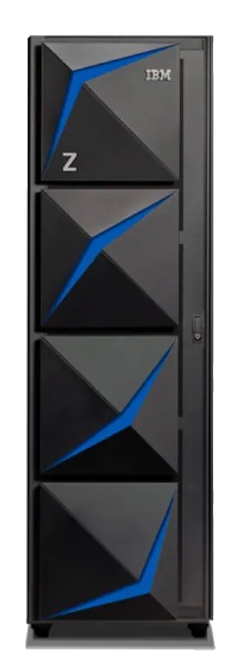

X
X
X
Where failure
marks the spot
Where failure
marks the spot
Where failure
marks the spot
blah, blah, haker
blah, manefram,
blah, blah…
Keep
Weird
Keep
Keep
Weird
Weird

Slide 13


IF FOUND, DROP IN ANY MAILBOX
RETURN POSTAGE GUARANTEED
NO. 133789797679420
Approved
and
Calibrated
A7
YN6A
PROPERTY OF
FBI SURVEILLANCE VAN
NO. 17
This item has been inspected and certified by
authorized agents of the bureau of certification.
Warning: This may or may
not contain Biological Matter
from Matt Damon.
DO NOT OPEN WITHOUT PROPER AUTHORIZATION
AND PROTECTIVE GEAR
Remember:
The Algorithm loves you
The Algorithm is your friend
The Algorithm is life
DO NOT CROSS THE ALGORITHM
RE-ORDER 8675309
An unofficial Defcon notice &!^
My SCIF
is a blanket fort
CAUTION
Are
always
bad
I’m not
a bot
Beep-boop
Unusual items detected in
hacking area.
Please remove items
Immediately.
Bad font
choices

